Slide 1
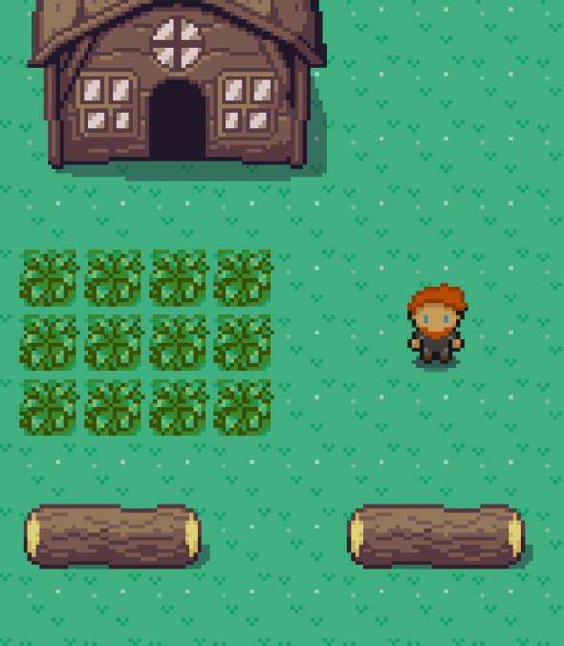
Kingdom of Souls
Game by Dominik Wizany and Ajdin Keric

Slide 2

Idea
Create an RPG with pixel optic inspired by classics like Final Fantasy
Make the gameplay feel fresh by adding a few new gimmicks
Create an interesting and thrilling story

Slide 3
Principle of the game
In the beginning you pick one out of five classes
Each class has different abilities and strengths
You travel the game world while progressing through the game
As you travel you will have to fight monsters
After each battle you will get stronger
You will meet new people as you progress who might join you

Slide 4
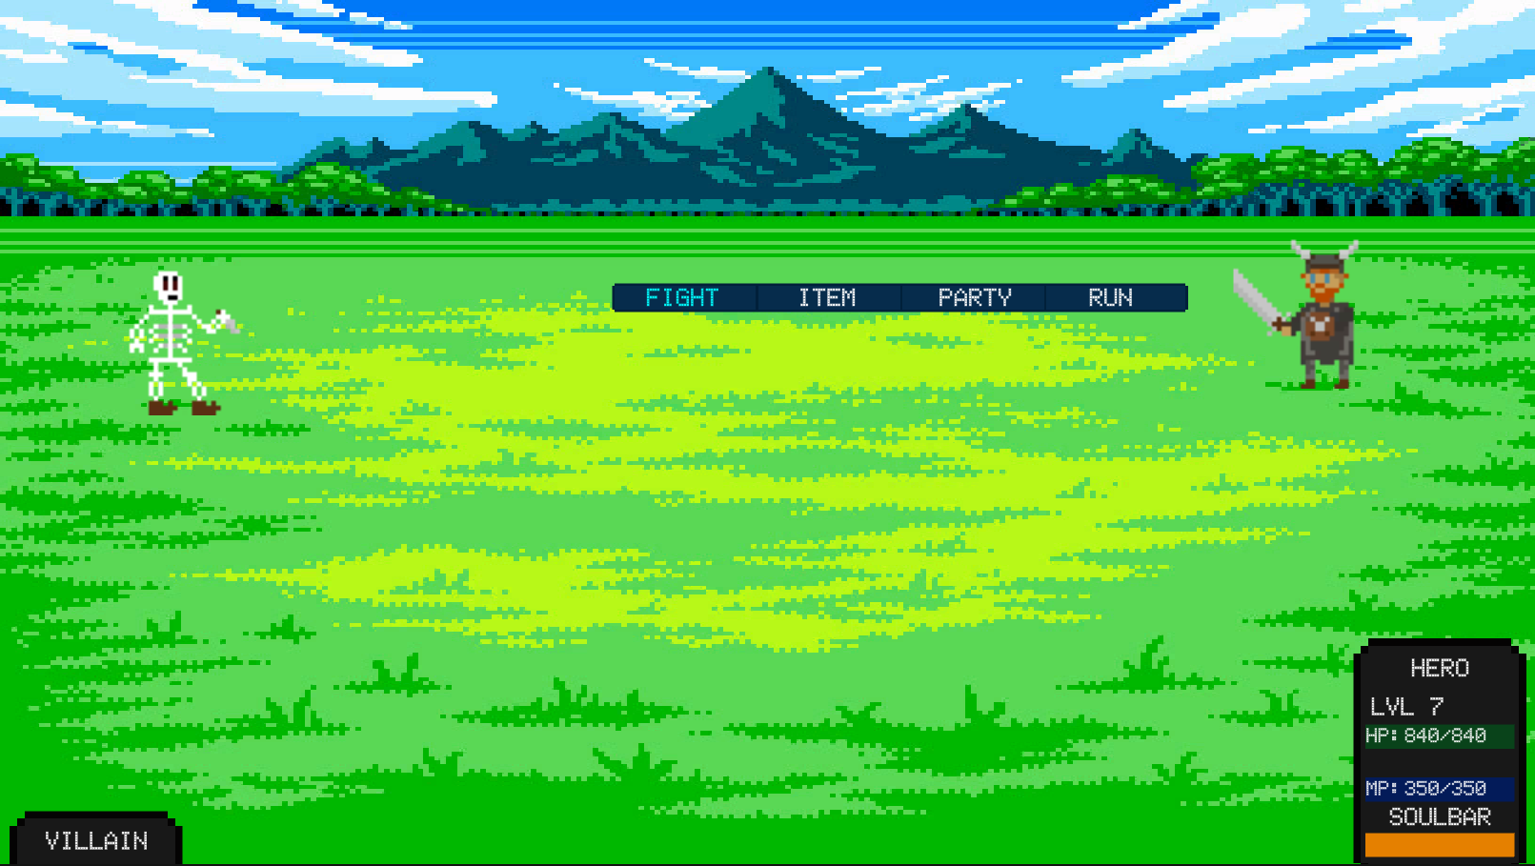
Battle
Classical turn based battle system
Soulbar charges up after each attack
If it is full you can use an empowered attack
Each enemy has a magical shield which reduces damage
You can break it by hitting them with an element they are weak to
Two party members can attack together with a partner attack

Slide 5
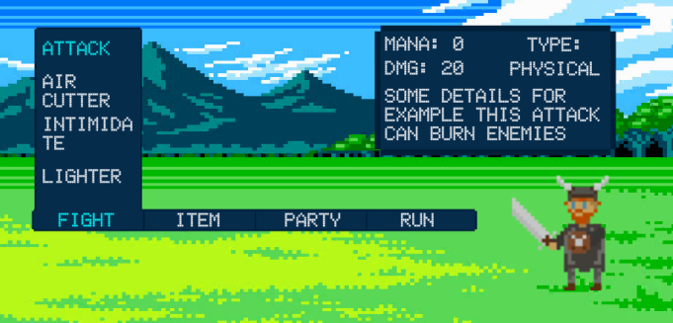
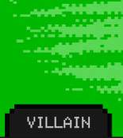
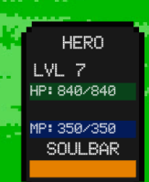
Interface

Slide 6

Story
2 kingdoms -> Kingdom of Souls, Kingdom of the Undead
Undead King was sealed -> got freed by cultists
Suprise attacked Kingdom of Souls -> whole kingdom got conquered
You as the main character are going on an adventure:
You meet new people who fight alongside you
Reconquer the kingdom
Explore new places around the world
Stop the Undead King by sealing him

Slide 7
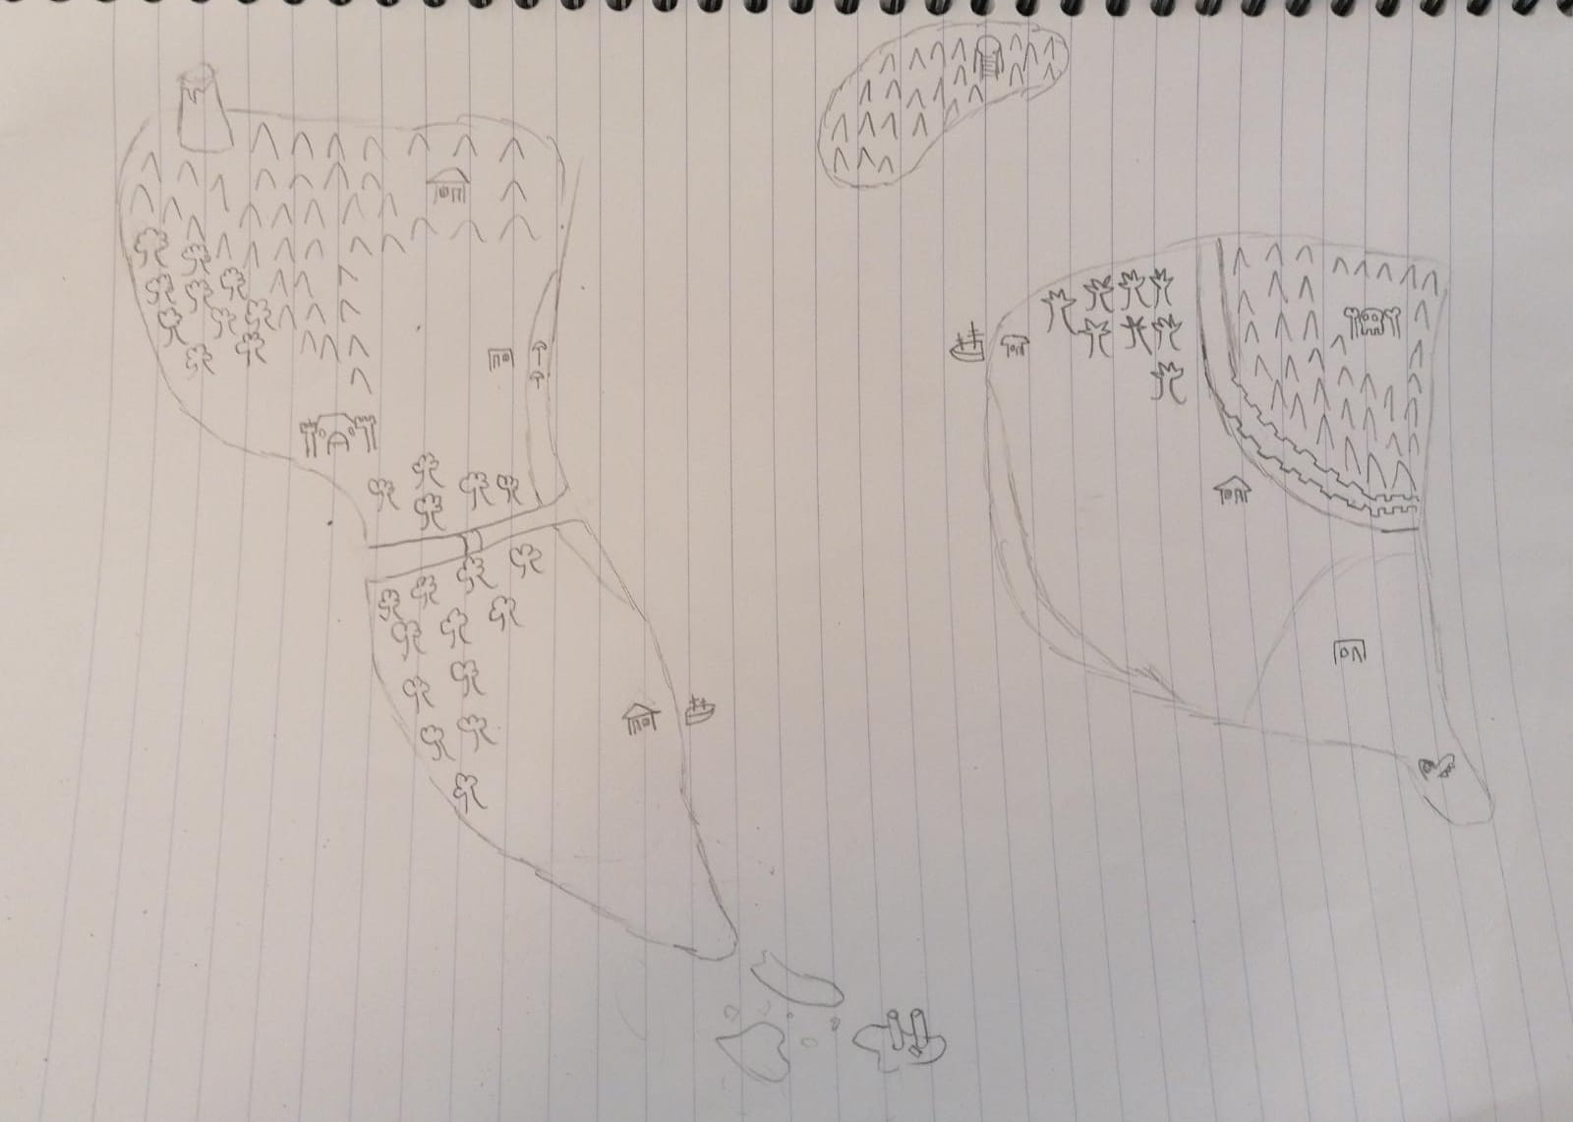
Map

Slide 8


Our Technologys
Backend
Game Engine

Slide 9
Live Demo

Slide 10
Thanks for listening!
Feel free to ask any question!

